Slide 1
Overview of CSE 445
&
Machine Learning
Dr. Sifat Momen

Slide 2
Lecture
MW 9:40 am - 11:20 am
Section: 1

Slide 3
About the course
Senior Level Course
It is expected that students should be able to demonstrate high degree of maturity
This include reading and learning on own from existing literature, writing codes, conducting experiments, analyzing results and writing good technical paper(s).

Slide 4
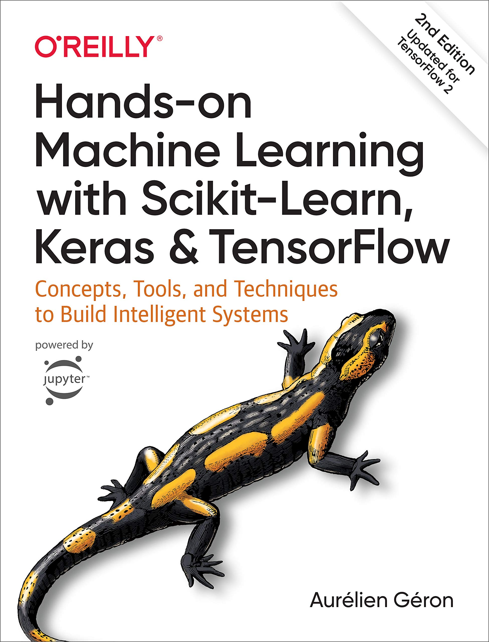
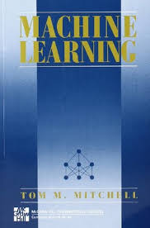
Recommended Materials
Lecture Materials
Scholarly papers

Slide 5
Project
The objective of the project work is to
Experience a hands on skills in ML.
Students will have to do innovative projects.
I am not expecting the projects to have commercial value but it must address a realistic problem and should solve it.
The project must not be banal
It should be ideally publishable in a reputed conference/ journal.

Slide 6
What is expected of you
Hard work
Inquisitive mind
Continued effort (You will NOT be able to magically do your project overnight)
Consistency is the key to do well in this course

Slide 7
Pre-requisites
Linear Algebra (MAT 125)
Statistics (MAT 361) [Statistical knowledge more than having ideas of mean, median, variance and standard deviation]
Understand algorithms and time complexity (CSE 373)
English (Good academic writing)

Slide 8
Courses that have some similarities to CSE 445
CSE 419 (Data Mining)
CSE 465 (Pattern Recognition and Neural Network)
CSE 468 (Computer Vision)
CSE 495 (Special Topic - this semester we are offering NLP)

Slide 9
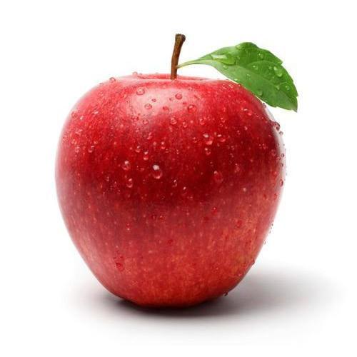
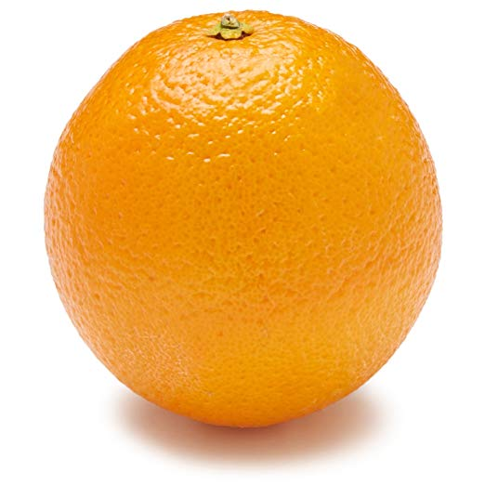
A thought Experiment
Imagine you have a physical machine that can take a (side view) picture of an object placed on it and can also measure the weight of the object.
You are to write a program that will identify the object (which is either an apple or an orange) from its image and weight value.
How would you approach it?.

Slide 10
Attributes/Features
The measurable features in this thought experiment are:
Color
Weight
The task is to design a classifier that can classify the type of fruit placed on this machine. Any idea how you can approach it?

Slide 11
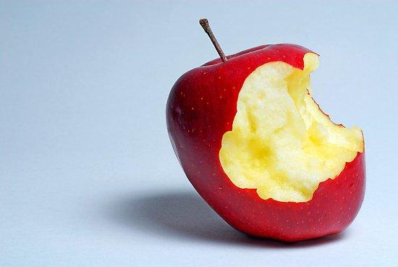
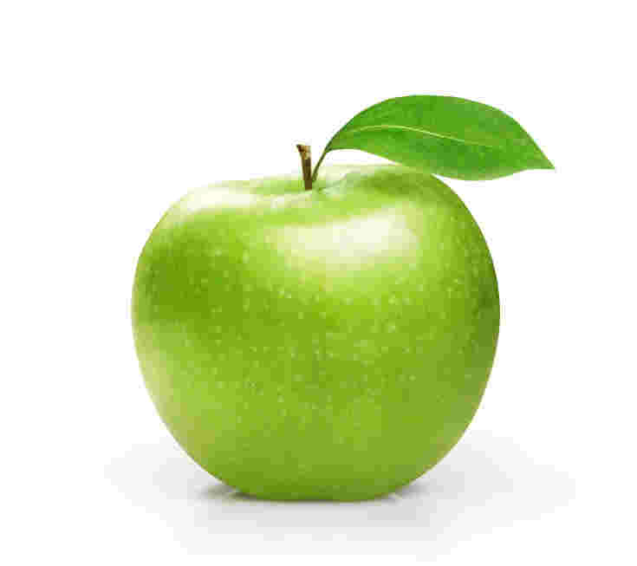
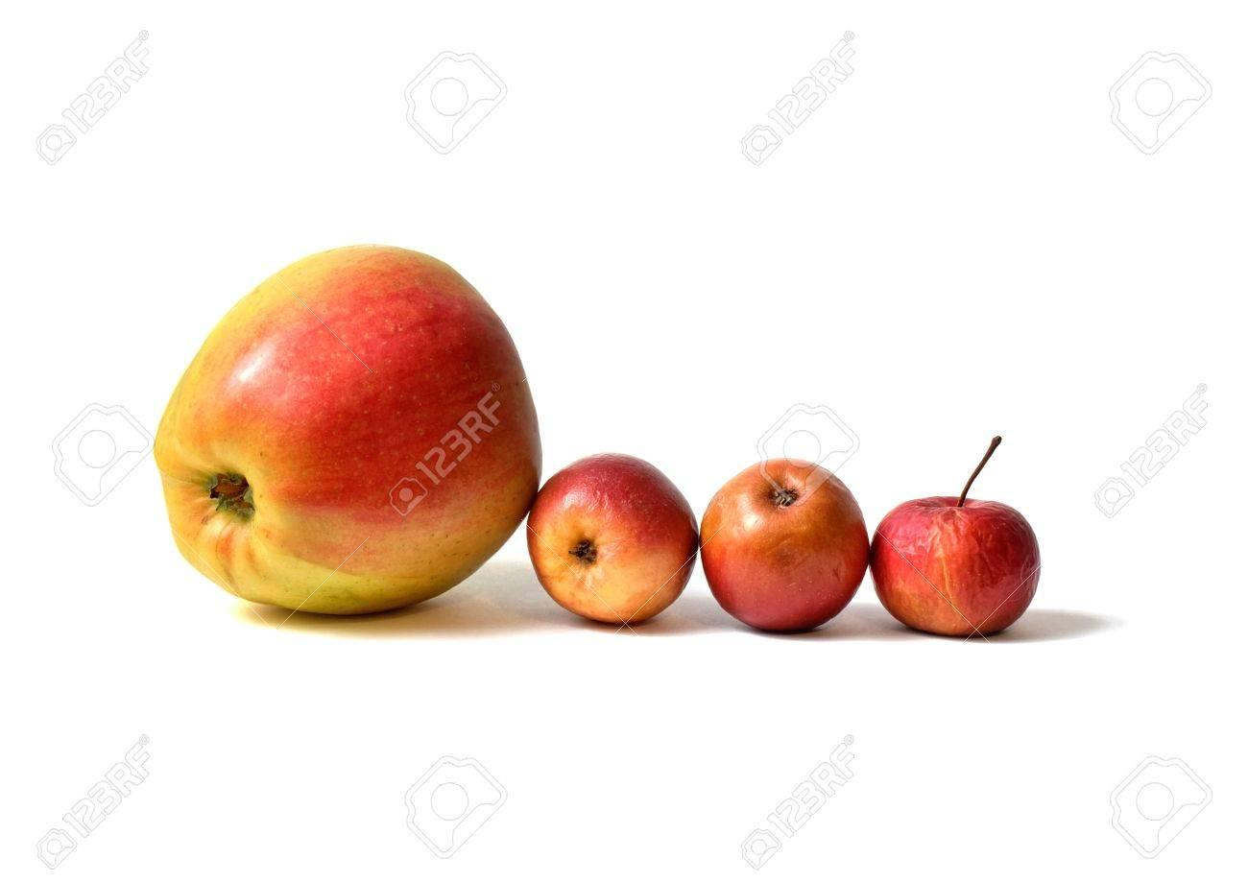
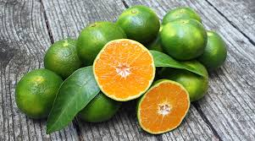
Real World

Slide 12
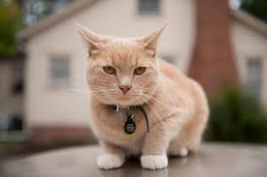


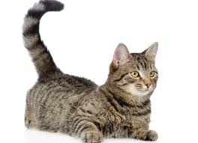






What about recognizing a cat from a picture?

Slide 13
Real World Data
Noisy
Illumination
Occlusion
Camera angle
Exists a wide range of variation (in terms of features such as color, texture, weight etc..)

Slide 14
Real World Data (cont…)
Consequently, it is impossible to write a rule based programming to recognize a cat or differentiate between fruits (such as orange and apple)
A shift in the paradigm is required
Data driven Computing (Welcome to Machine Learning)
We use data to train a machine to do a number of things
Data is at the core of ML
Without data, you will not be able to run a ML project.

Slide 15
Well posed learning problems
Machine Learning
It is a science that grew up from AI
The term, ML, was coined in 1959, by Arthur Samuel
A computer program is said to learn from experience E, with respect to some task T and performance measure P if its performance at task T, as measured by P, improves with experience E. (Tom M. Mitchell)

Slide 16
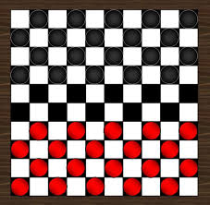
Checkers learning problem
Task T: playing checkers
Performance measure, P: % of games won against opponents
Training Experience, E: Playing practice games against itself

Slide 17
Handwriting Recognition Problem
Task T: Recognizing and classifying handwritten words/characters within images
Performance measure P: % of words/characters correctly classified
Training Experience, E: Predicting the word/character from a collection of handwritten words/characters with given classifications
MNIST Dataset (Yann Lecunn et al.)
BanglaLekha Isolated (Nabeel Mohammed, Sifat Momen et al.)
https://data.mendeley.com/datasets/hf6sf8zrkc/2
Dataset comprises of 50 Bangla basic characters, 10 bangla numerals and 24 selected compound characters (total of 1,66,105 handwritten character images)

Slide 18
Robot driving learning problem
Task T: driving on public highways using vision sensors
Performance measure, P: Average distance travelled before an error (as judged by a human observer)
Training Experience, E: A sequence of images and steering commands recorded while observing a hums driver.

Slide 19
Classifying an incoming email as either a spam or not spam
Task T: Correctly classify an email as either spam or not spam
Performance measure, P: % of emails correctly classified
Training Experience, E: A repertoire of emails with proper labeling as either spam or not.

Slide 20
Different types of learning
Supervised learning
Semi-Supervised learning
Unsupervised learning
Reinforcement learning

Slide 21
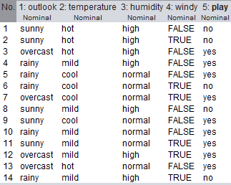
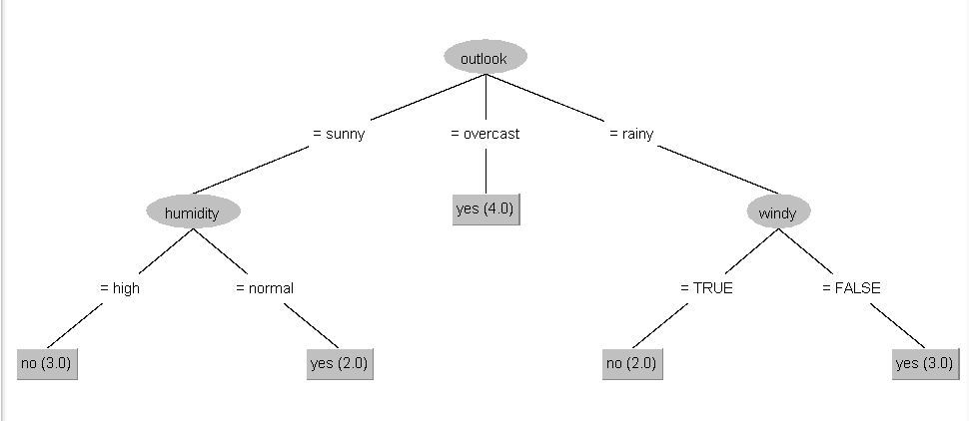
Supervised Learning
In supervised learning, the algorithm builds a mathematical model from a set of data that contains inputs and desired outputs <X, y>.
The data contains 14 instances and 4 attributes. The target variable is play
A Decision Tree Model

Slide 22
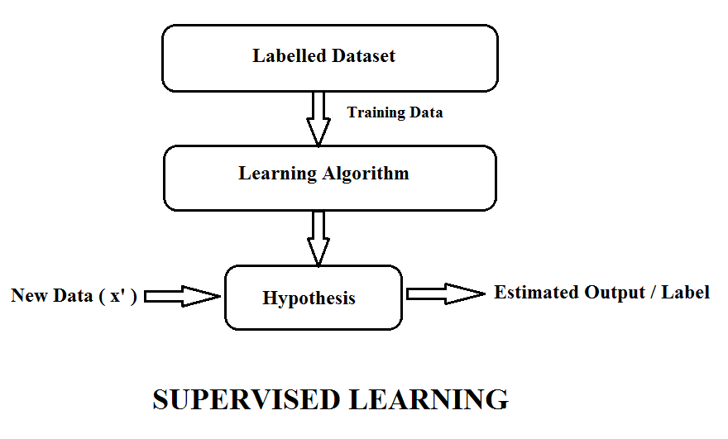
Supervised Learning

Slide 23
Supervised Learning
Classification
Classification algorithms are used when outputs are restricted to some discrete set of values
E.g. classifying whether an email is a spam email or not, whether a tumor is malignant or benign.
Classifying from medical records whether a pregnancy is high risk or not.
Classify the specie of iris https://en.wikipedia.org/wiki/Iris_flower_data_set
Regression
Regression algorithms are used when outputs have continuous values i.e. they may have any value within the range.
E.g. predicting the price of a house from location, size of the area and number of rooms

Slide 24
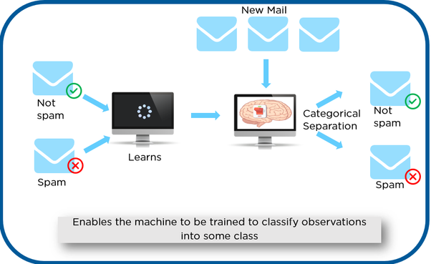
Supervised Learning - Classification

Slide 25
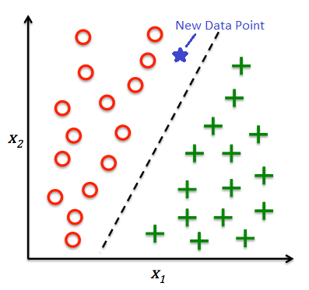
Supervised learning - Classification

Slide 26
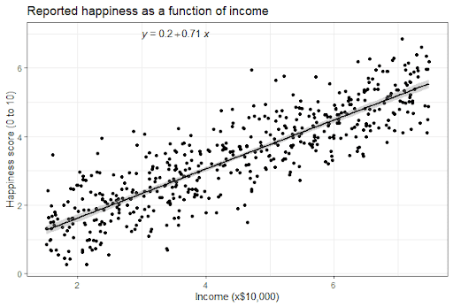
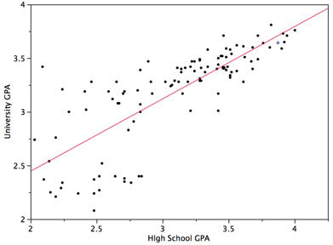
Regression

Slide 27
Unsupervised Learning
Unsupervised learning algorithms take a set of data that contains only inputs, and find structure in the data, like grouping or clustering of data points.
The algorithms therefore learn from test data that has not been labeled, classified or categorized
Instead of responding to feedback, unsupervised learning algorithms identify commonalities in the data and react based on the presence or absence of such commonalities in each new piece of data.

Slide 28
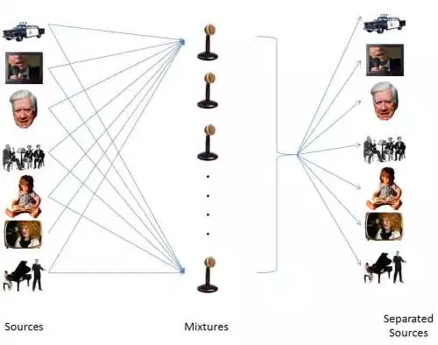
The Cocktail Party Problem

Slide 29
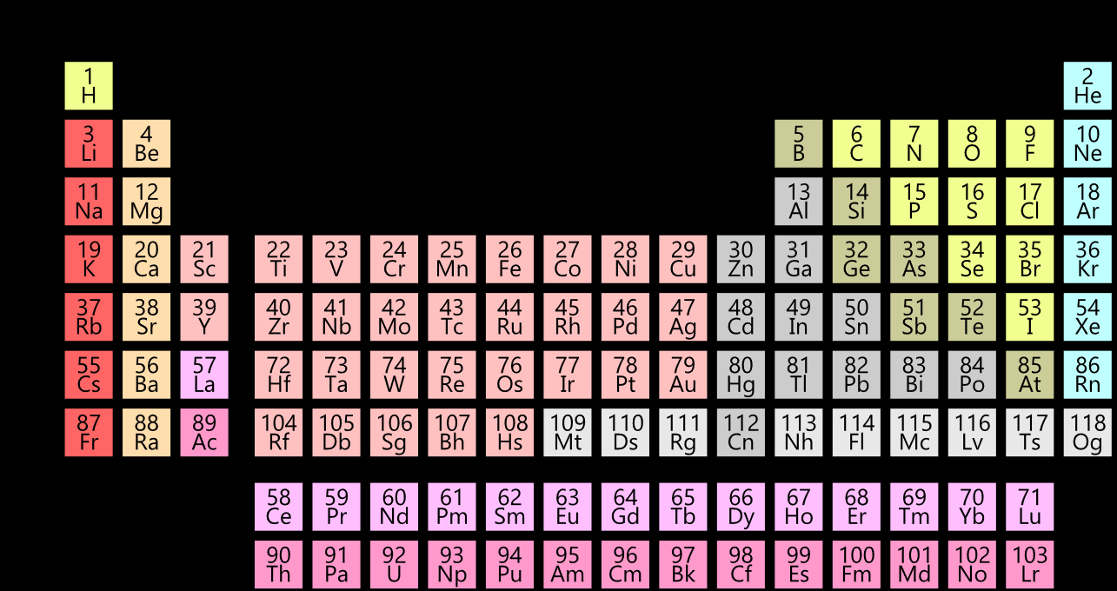
Unsupervised Learning

Slide 30
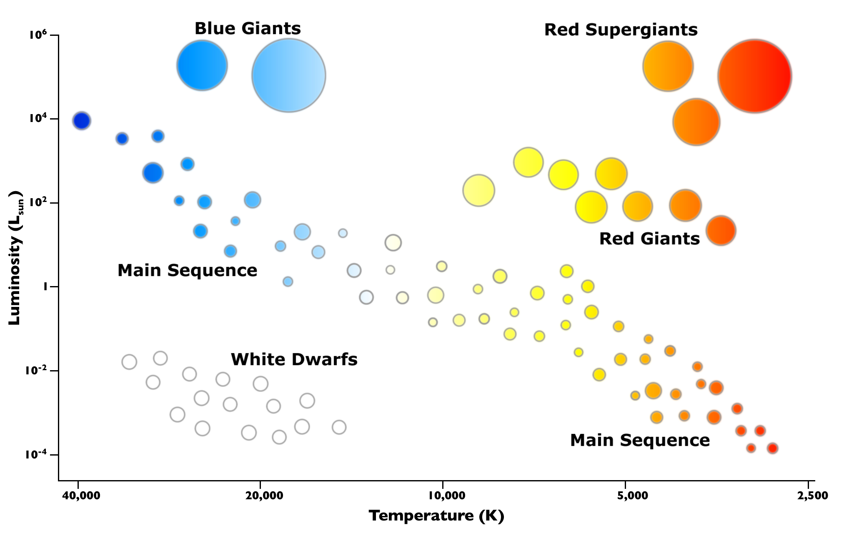
Unsupervised Learning

Slide 31
Semi-Supervised Learning
Supervised learning works on labeled data
Unsupervised learning works on unlabeled data
In Semi-Supervised learning, the training data contains both labeled and unlabeled data
Scenario
We have a large dataset. Manual labeling of the entire dataset is laborious and expensive
One solution could be to label a sample of the dataset and train the labeled portion to create a model. This would however mean that we are not fully utilizing the larger dataset we have and thus the model that we create may be less robust
A potential solution: (1) Label a sample of the large dataset, (2) train a model using this labeled portion, (3) use the model to predict the unlabeled portion (pseudo-labeling), (4) train using the entire dataset

Slide 32
Issues related to AI (and more particularly ML)
ML model depends on the data that is fed.
Bias in the data (conscious / unconscious) can be easily picked up by ML models
ML systems used for criminal risk assessment have been found to be biased against black people.

Slide 33
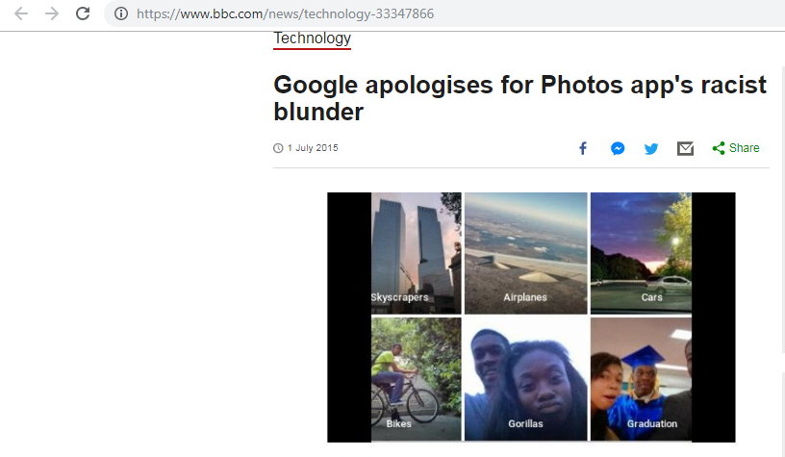
Issues Related to ML

Slide 34
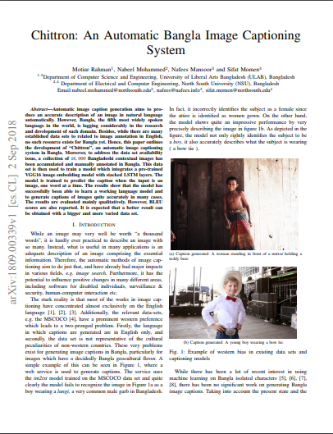

Slide 35
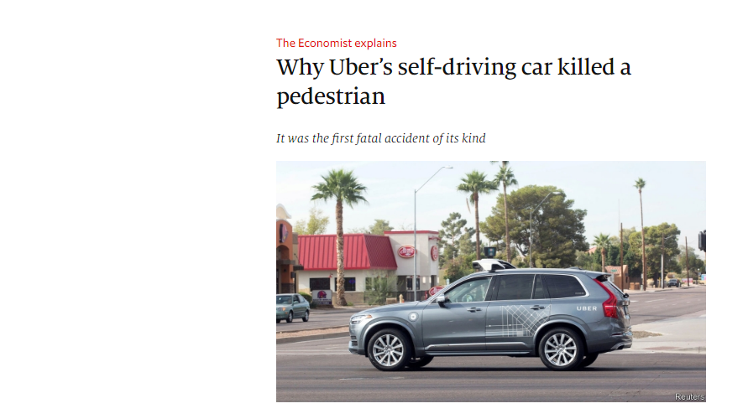

Slide 36
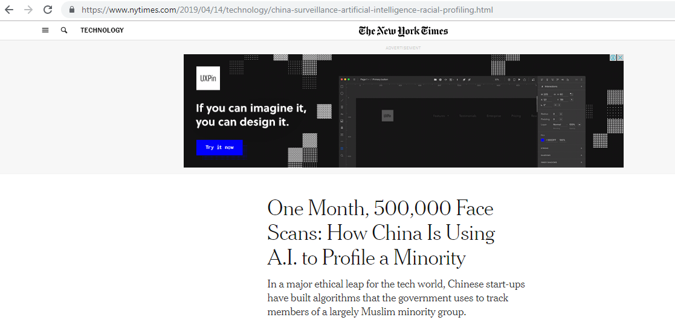

Slide 37
ML and Ethics (More Complex case)
When applied to people, data mining is frequently used to discriminate - who gets the loan, who gets the special offer, and so on.
Certain kinds of discrimination - racist, sexual, religious and so on are not only unethical but also illegal.
Using sexual and racist information for medical diagnosis is certainly ethical but using the same information when mining loan payment behavior is not.

Slide 38
ML and Ethics (Difficulty to solve it)
Reidentification techniques has provided sobering insights into the difficulty of anonymizing data.
85% of the Americans can be identified from just three pieces of information, zip code, birth date and sex.

